Slide 1
Assignment #2 An Exercise of SQL Using SQL*Plus
KAIST
Myoung Ho Kim

Slide 2
Table of Contents
SQL*Plus
Oracle SQL*Plus
Access to database
SQL*Plus Commands
Assignment #2
SQL Queries

Slide 3
SQL*Plus

Slide 4
Oracle SQL*Plus
An Oracle command-line utility program that can run SQL commands interactively or from a script.
SQL statement
SQL*Plus
Oracle DB server
Result
DB

Slide 5
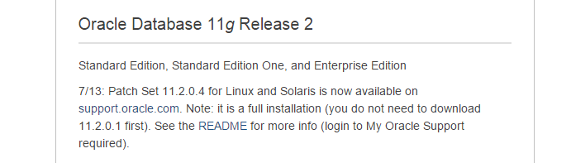


Access to DB using SQL*Plus
Install Oracle Client
http://www.oracle.com/technetwork/database/enterprise-edition/downloads/index.html
Scroll down to Oracle Database 11g Release 2
Click See All

Slide 6


Access to DB using SQL*Plus (Cont’d)
Install Oracle Client
Download Oracle Database 11g Release 2 Client
Run setup.exe
Install ‘Manager’ type

Slide 7
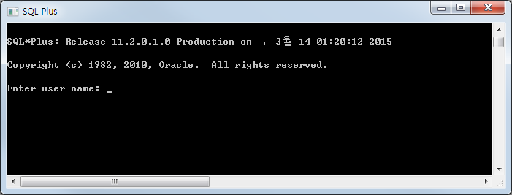
Access to DB using SQL*Plus (cont’d)
Run SQL Plus
Download tnsnames.ora from course homepage and copy it to (directory that Oracle Client is installed: ex. C:\app\MyDirect\product\11.2.0\client_2)\network\admin
Run SQL Plus

Slide 8
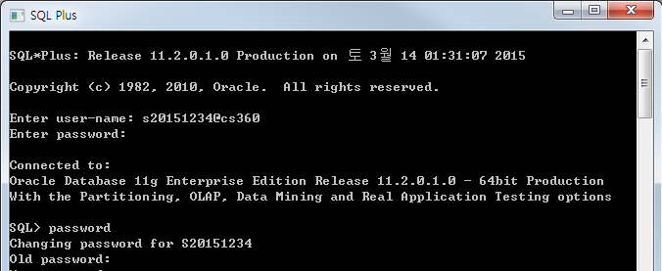
Access to DB using SQL*Plus (cont’d)
Access to database
User-name: s[studentID]@cs360
ex) If your studentID is 20151234, then your user-name is s20151234@cs360
Password: s[studentID]
ex) If your studentID is 20151234, then your password is s20151234
It is recommended to change your password for security

Slide 9
SQL*Plus Commands

Slide 10
SQL*Plus Commands
SQL*Plus buffer commands
LIST List one or more lines of the SQL buffer
CHANGE Change text on the current line in the buffer
DEL Delete one or more lines of the buffer
APPEND Add specified text to the end of the current line in the buffer
RUN Execute the SQL command currently stored in the SQL buffer
CLEAN BUFFER Erase the SQL command currently stored in the SQL buffer
SQL*Plus file commands
SAVE Save the contents of the SQL buffer in a host operating system file
GET Load a host operating system file into the SQL buffer
START Execute the contents of the specified script
SPOOL Store query results in an operating system file (.sql)
HOST Execute a host operating system command without leaving SQL*Plus
EDIT Open a text editor like the notepad to edit an text file (.sql, .lst, etc)

Slide 11
SQL*Plus Commands (cont’d)
SQL*Plus buffer commands
Besides sending SQL statements to the server, SQL*Plus also saves them into a local buffer and allow users to view and change the statements
LIST
Display one or more lines of the SQL buffer
CHANGE
Change text on the current line in the buffer
RUN(or /)
Execute the SQL command currently stored in the SQL buffer

Slide 12
SQL*Plus Commands (cont’d)
SQL*Plus buffer commands
DEL
Delete one or more lines of the buffer
APPEND/ INPUT
Add specified text / line(s) to the end of the current line in the buffer
CLEAR BUFFER
Erase the SQL command currently stored in the SQL buffer

Slide 13
SQL*Plus Commands (cont’d)
SQL*Plus buffer commands
LIST, CHANGE
SQL> select customer_numberr
2 , email
3 from customer
4 where state='TX';
select customer_numberr
*
ERROR at line 1:
ORA-00904: “customer_numberr": invalid identifier
SQL> list;
1 select customer_numberr
2 , email
3 from customer
4* where state='TX‘
SQL> list 1;
1* select customer_numberr
SQL> change /numberr/number;
1* select customer_number
SQL> list;
1 select customer_number
2 , email
3 from customer
4* where state='TX‘
List the first line
Change text
on the current line
Show the contents
in the sql buffer
Show the contents
in the sql buffer

Slide 14
SQL*Plus Commands (cont’d)
SQL*Plus buffer commands
RUN(or /), DEL
SQL> list;
1 select customer_number
2 , email
3 from customer
4* where state='TX‘
SQL> /
CUSTOMER_NUMBER EMAIL
---------------------------- ---------------------------
321654987 bfarmer@email.com
SQL> list;
1 select customer_numberr
2 , email
3 from customer
4* where state='TX‘
SQL> del 4;
SQL> list;
1 select customer_number
2 , email
3* from customer
Show the contents
in the sql buffer
Show the contents
in the sql buffer
Delete the 4th line
Execute the command
currently stored
in the sql buffer
Show the contents
in the sql buffer

Slide 15
SQL*Plus Commands (cont’d)
SQL*Plus buffer commands
APPEND
SQL> list;
1 select customer_numberr
2 , email
3 from customer
4* where state='TX‘
SQL> list 2;
2* , email
SQL> append ,city
2* , email,city
SQL> list;
1 select customer_number
2 , email,city
3 from customer
4* where state='TX'
SQL> /
CUSTOMER_NUMBER EMAIL CITY
-------------------------------- ----------------------- -----------------------
321654987 bfarmer@email.com DALLAS
Show the contents
in the sql buffer
Show the contents
in the sql buffer
Show the second line
Execute the command
currently stored
in the sql buffer
Add text to the end
of the current line
in the buffer

Slide 16
SQL*Plus Commands (cont’d)
SQL*Plus buffer commands
INPUT, CLEAR BUFFER
SQL> list;
1 select customer_number
2 , email,city
3 from customer
4* where state='TX'
SQL> del 4;
SQL> list;
1 select customer_number
2 , email,city
3* from customer
SQL> input where state='FL'
SQL> list;
1 select customer_number
2 , email,city
3 from customer
4* where state='FL'
SQL> clear buffer;
Buffer cleared
Add a line to the end
of the current line
in the buffer
Show the contents
in the sql buffer
Show the contents
in the sql buffer
Delete the 4th line
Show the contents
in the sql buffer
Erase the commands
currently stored
in the buffer

Slide 17
SQL*Plus Commands (cont’d)
SQL*Plus file commands
SAVE, GET, START(or @)
Save the contents of the SQL buffer into a script file
Load a contents of script file into the SQL buffer
Execute the contents of the specified script
SPOOL
Store query results in an operating system file
SPOOL result.lst : start to write in result.lst
SPOOL OFF : stop to write
HOST
Execute a host operating system command without leaving SQL*Plus
ex) HOST dir : execute a MS-DOS command dir

Slide 18
SQL*Plus Commands (cont’d)
cf. If you cannot execute these commands, please run SQL*Plus in administrator mode
SQL*Plus file commands
SAVE, GET, START(or @)
SQL> select customer_number,
2 email, city from customer
3 where state='TX';
CUSTOMER_NUMBER EMAIL CITY
----------------------------- -------------------------- ----------------
321654987 bfarmer@email.com DALLAS
SQL> save query.sql;
SQL> get query.sql;
1 select customer_number,
2 email, city from customer
3 where state='TX'
SQL> @query.sql
CUSTOMER_NUMBER EMAIL CITY
----------------------------- -------------------------- ----------------
321654987 bfarmer@email.com DALLAS
Save buffer contents
into a file
Retrieve a file
and place it
into the buffer

Slide 19
SQL*Plus Commands (cont’d)
SQL*Plus file commands
SPOOL, HOST
SQL> spool result.lst
SQL> create table Spooled(name char(10));
Table created.
SQL> spool off
SQL> create table NotSpooled(name integer);
Table created.
SQL> spool result.lst append
SQL> create table anotherSpooled(name char(10));
Table created.
SQL> spool off
SQL> host dir
result.lst schema.sql insert.sql
SQL> edit result.lst
Start to write
in result.lst
Stop to write
Stop to write
Execute
a command ls
Open result.lst
to see or edit
Restart to write
in result.lst

Slide 20
Assignment #2

Slide 21
Submission
Due
Sep. 23, 2:00 a.m.
Delay is not accepted
Submission standard
[student ID].lst contains the executions of SQL commands and their results. You may use SPOOL command.
Upload the .lst file to course homepage
Evaluation
You will get points if your SQL queries find the right answers.
Do not cheat others. Both of them will get no point.

Slide 22
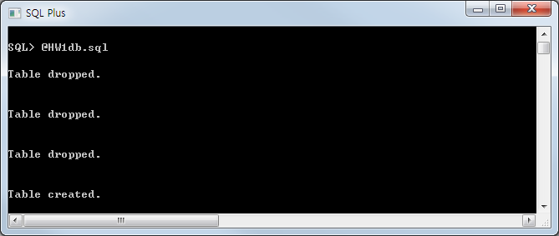
Example Database
Create tables for homework.
Download HW2db.sql from the course homepage and Copy it to (directory that Oracle Client is installed)\BIN
@HW2db.sql or start HW2db.sql

Slide 23
Example Database (cont’d)
Database Design
You can see all the tables stored in your database using a command ‘select * from tab’
PRODUCT | maker | model | type
 | A | 2001 | pc
 | A | 1002 | pc
 | …
PC | model | speed | ram | hd | price
 | 1001 | 2.66 | 1024 | 250 | 2114
 | 1002 | 2.10 | 512 | 250 | 995
 | …
PRINTER | model | color | type | price
 | 3001 | true | Ink-jet | 99
 | 3002 | false | laser | 239
 | …
LAPTOP | model | speed | ram | hd | screen | price
 | 2001 | 2.00 | 2048 | 240 | 20.1 | 3673
 | 2002 | 1.73 | 1024 | 80 | 17.0 | 949
 | …

Slide 24
Queries
Q1. Find all the tuples in the Printer relation for color printers. Remember that color is a boolean-valued attribute.
If a value of color attribute is 1 then the printer is a color printer.
If a value of color attribute is 0 then the printer is not a color printer
Q2. Find the model number, speed, and hard-disk size for all PC’s whose price is under $800.
Q3. Find the manufacturers of laptops

Slide 25
Queries
Q4. Find those manufactures that sell PC’s but not Laptops
In oracle, the operator for difference of sets is ‘MINUS’ (instead of ‘EXCEPT’)
Q5. Find the model number and price of all products (of any type) made by manufacturer C
Q6. Find those processor speeds that occur in two or more PC’s

Slide 26
References
Lecture notes
Text book
Chapter 6.1, 6.2, 6.3
Oracle SQL Plus Tutorial
http://www.holowczak.com/oracle/sqlplus/

